Slide 1
Boids Swarm
A Game Mechanic

Slide 2
Method
AI -- Swarm Intelligence
- Flocking
- Collective behaviour
Boids flock
Flocking behaviour of birds
Three main rules
Cohesion
Alignment
Avoidance/Separation

Slide 3
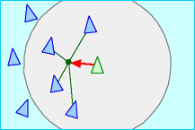
Cohesion
steer to move toward the average position (center of mass) of local flock agents
steered cohesion

Slide 4
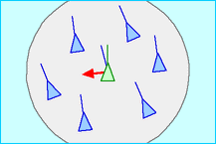
Alignment
steer towards the average heading of local flock agents

Slide 5
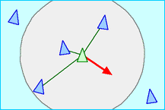
Avoidance/Separation
steer to avoid crowding local flock agents

Slide 6
Game Mechanic
Enemy
Patrol
Heal
Boosts (Speed)
Hover

Slide 8
Decreases health

Slide 9
Safe Zones
Type 1 Type 2

Slide 10
Increases health

Slide 14
Other features
Field-of-view of agents
Different kind of boosts - invulnerability, slow-down, regenerate
Type 3 safe zone

